Slide 1
Internet Of Things
Devices, Cloud, Security
Stefano Semeraro

Slide 2
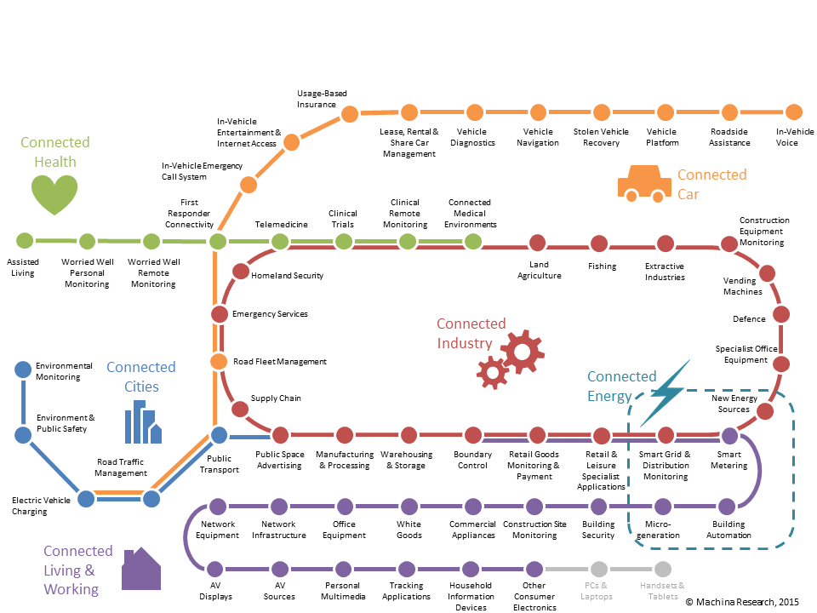
Internet of what?
What IoT is and what it isn’t
IoT in governement, business and consumer
Smart cities and smart factories
Research: towards IoCT (Internet of computing things)

Slide 3
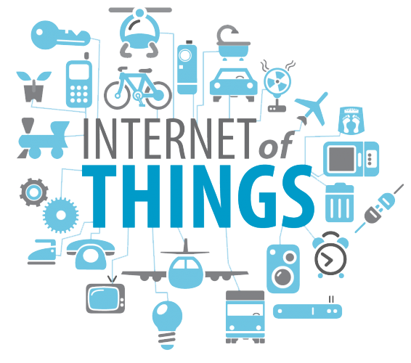

Key word: connectivity
Connection types (RF, GSM, powerline, wired bus, WiFi)
Machine to machine (M2M) communications: MQTT, the leading protocol for IoT (the publish/subscribe paradigm, topics and messages)
How to handle very poor network availability and reliability: Quality of service (QoS), retained messages and last will messages

Slide 4
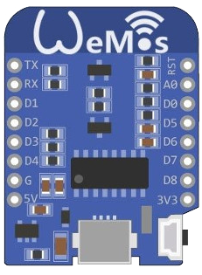
Internet of everything
Best way to boost the IoT spread: devices must cheap
How to build smart, small, reliable, sub-10€ devices that can access the nework
One of the most popular WiFi-enabled microcontroller: the ESP8266

Slide 5
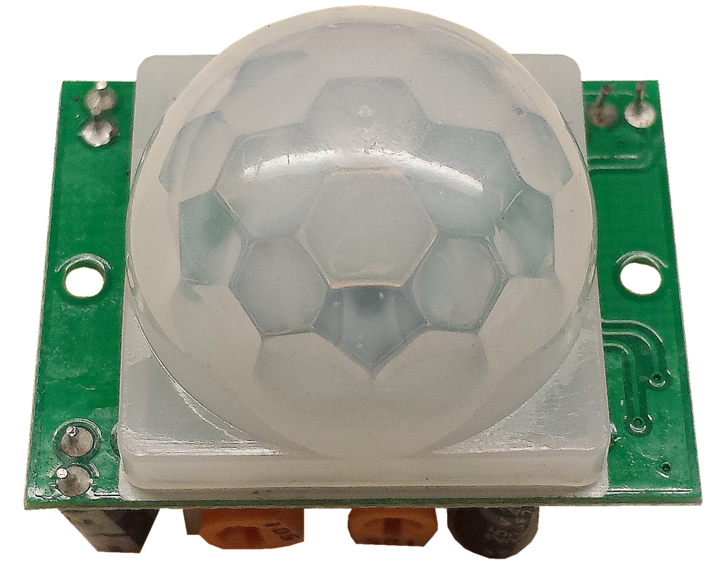
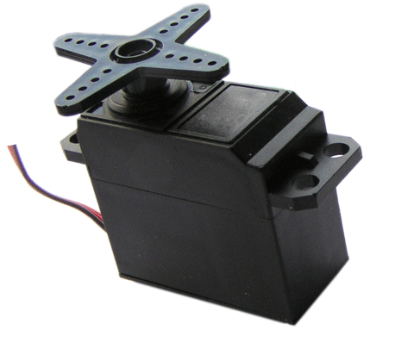
Bridging software with the real world
Sensors and actuators
Power sources
How to easily program a microcontroller: fast prototyping
DEMO: detect people and move a servomotor

Slide 6
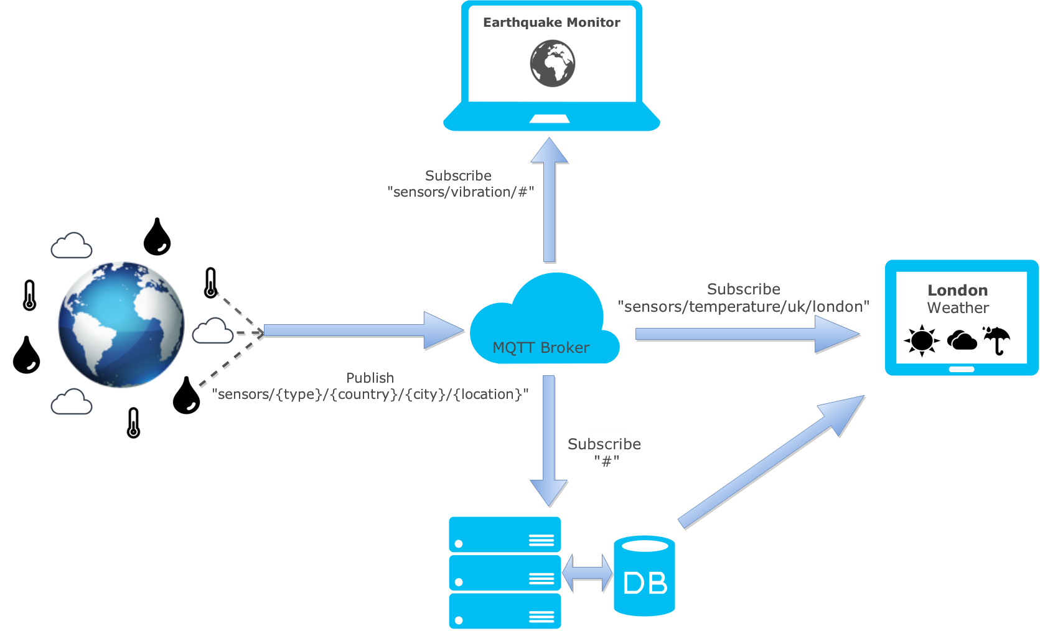
IoT in action
Connecting devices through MQTT: using the pubsubclient library to abstract all connectivity-related technicalities
DEMO: get push notifications and send commands in wireless

Slide 7
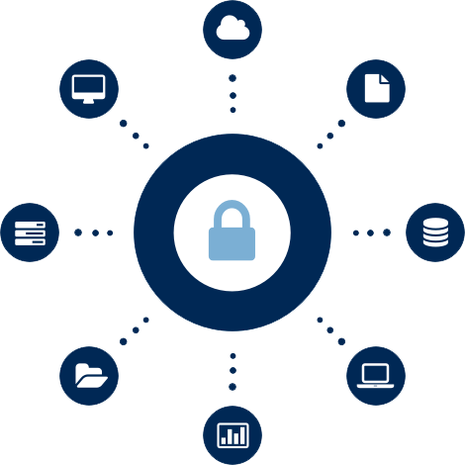
Security
When devices interact with the real world, security is by far the most important aspect to be cared of
Key concepts: authorization, authentication and encryption
How to implement robust security measures when devices have such a constrained computing power?
Delegating encryption to maintein trust boundaries

Slide 8
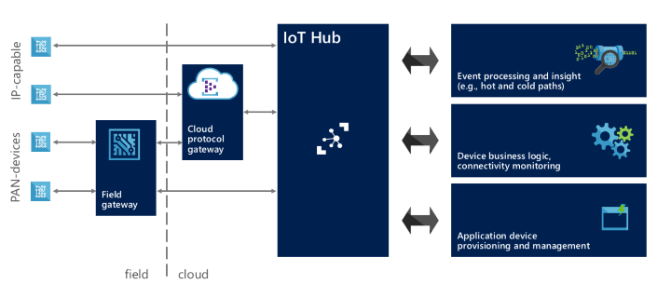
IoT in the cloud: Azure IoT hub
Very brief introduction to the Microsoft Azure platform-as-a-service (PaaS) solution
The Azure IoT hub
Connecting devices to Azure IoT hub through MQTT
DEMO: receive and process real world events in the cloud

Slide 9
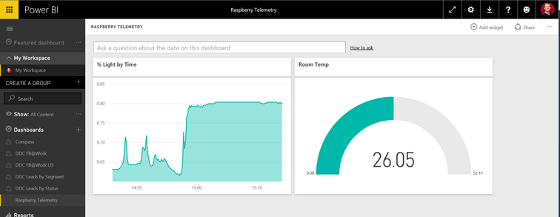
Gaining real-time insights from the world
Brief introduction to the Power BI cloud platform
Consuming Data on Azure IoT Hub into Microsoft Power BI
DEMO: a real-time, interactive, web-based dashboard

Slide 10
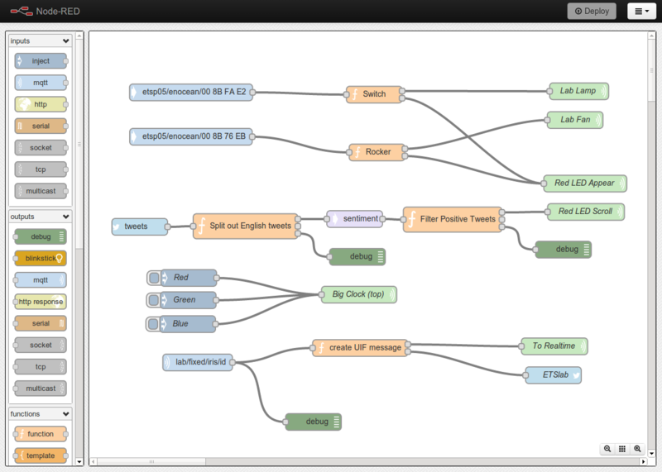
Wiring things and services
Node-RED: a node.js based web application for visually wiring together hardware devices, APIs and online services
Connect devices to Node-RED through MQTT
DEMO: automatically post social network updates when real world events happens

Slide 11
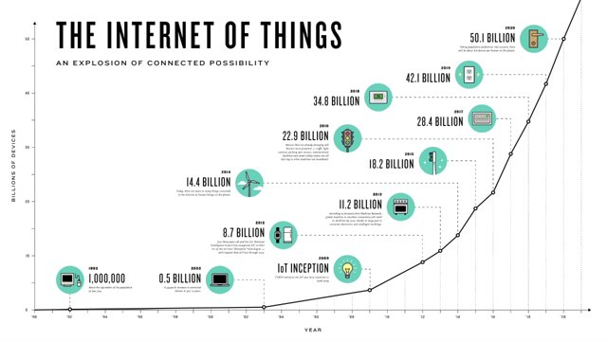
IoT: from technology to business
Practically use-scenarios of Internet of Things solutions
Who is investing in IoT today
IoT expectation for the next years
Analysis of relevant case studies

Slide 12


